Slide 1




ADIDAS SALES ANALYSIS
Unraveling the Secrets of Adidas' Sales Success 📊
A034 – Partha Lalit
A042 – Shreya Nadkarni

Slide 2


Problem Statement
PROBLEM STATEMENT
Despite being a leading brand in the sportswear industry, Adidas faces challenges in maximizing its sales and market share in the US market. The objective of this project is to analyze the Adidas sales database for the year 2020 and 2021 and identify key insights to help improve sales performance and optimize business strategies. By analyzing the sales data, we aim to understand factors influencing sales, identify trends, and uncover opportunities for growth.

Slide 3




Objectives
To identify the products that are generating the highest sales revenue.
To identify which retailer made the highest and least sales.
To identify which months or years had the highest and lowest sales figures.
To study how does sales performance vary across different sales methods.
To identify the regions that are driving the most sales for the business
1
2
3
4
5

Slide 4




Methodology
Data Collection
Data Pre-processing & Analysis
GUI & dashboard
Raw Data from Kaggle Website

Slide 5


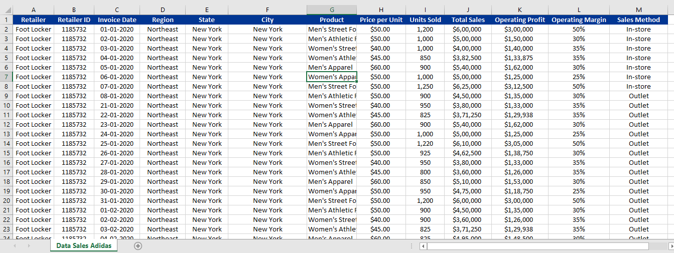














DATASET (data sourced from kaggle)
In the dataset, we had 9648 rows and 13 columns.

Slide 6






DATA PREPROCESSING
Handling Duplicates:
Check for and remove duplicate records to
avoid redundancy
Removing non-numeric characters from the columns:
numeric data contained non-numeric characters. Removed non-numeric characters such as currency symbols or commas
Data Inspection:
Begin by inspecting the dataset to identify potential issues.
Examine the structure, formats, and types of data in each column.
Feature Engineering:
dataset was transformed to enhance its suitability for analysis. Date details such as Weekday, Month, Quarter, and Year were extracted into separate columns
Handling missing data:
Imputed and removed the rows and columns which
had missing data

Slide 7

Exploratory Data Analysis

Slide 8

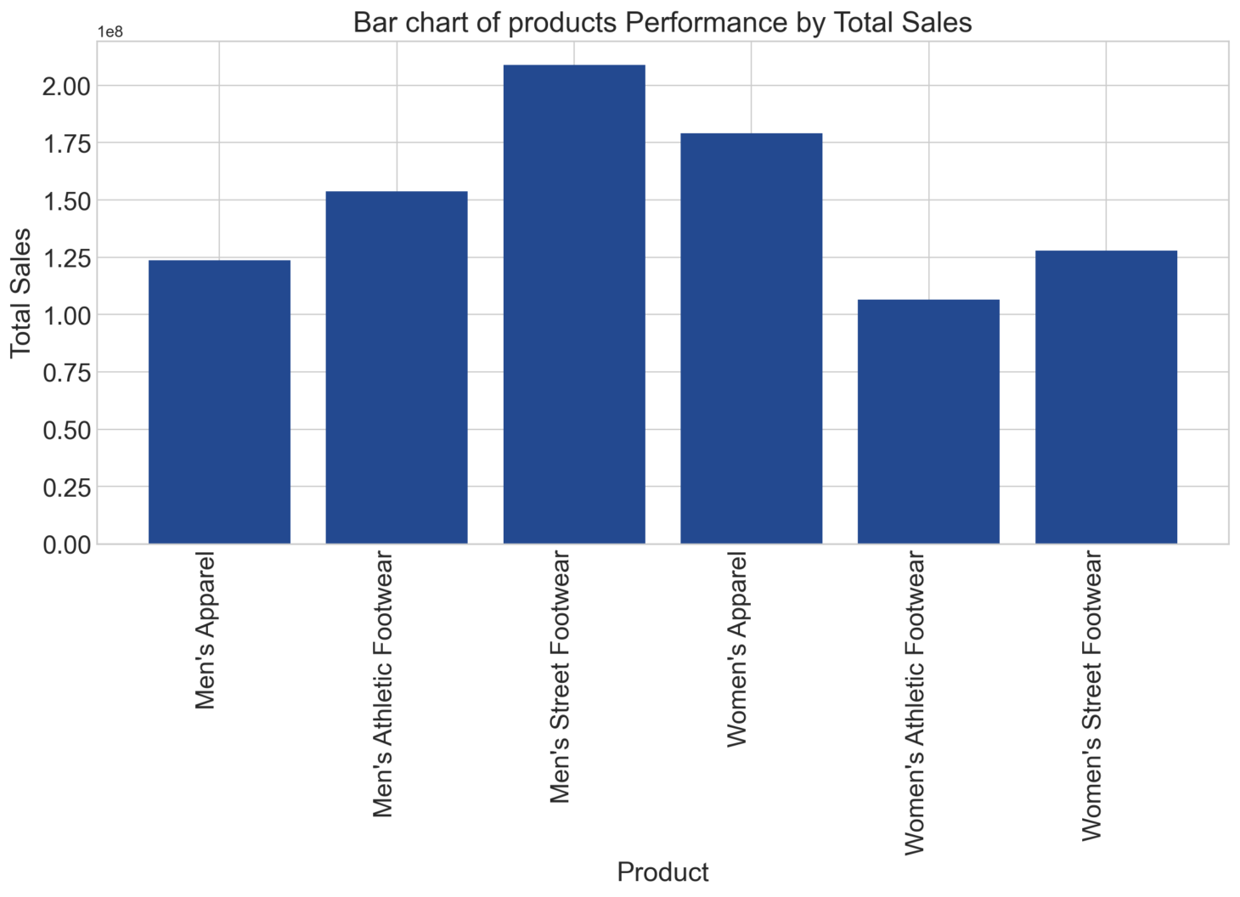
Sales Performance Analysis : Which products are generating the highest sales revenue ?
Men’s Street footwear was the top- selling product at 20,88,26,244 and Women’s Apparel at 179038860M

Slide 9
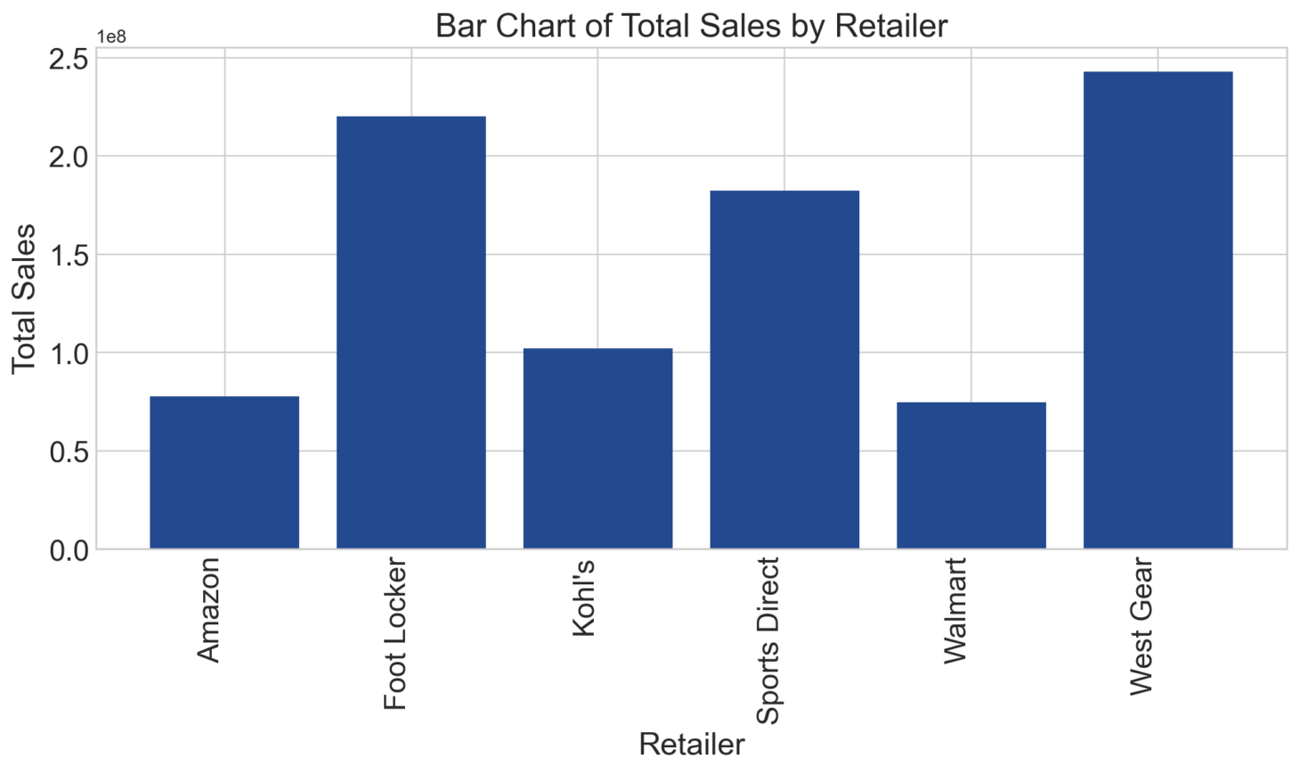
Retailer Sales Comparison : Which retailer made the highest and least sales?
West Gear and Foot Locker emerged as the top-performing retailers. Retailer “West gear” made the highest purchases, contributing to sales 242964333M, while retailer “Walmart” made the least sales of 74558410M.

Slide 10
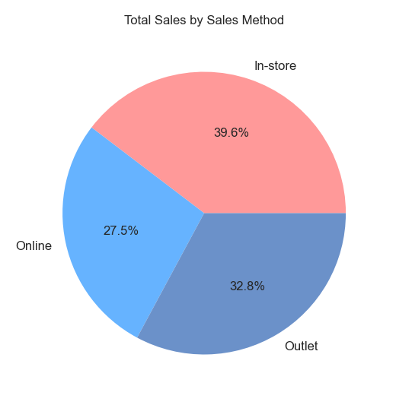
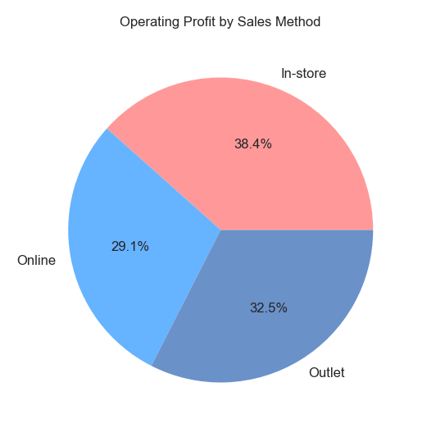
Efficiency of Various Sales Methods: How does sales performance vary across different sales methods?
In-store sales proved to be the most effective method, generating sales worth $356,643,750. On the other hand, online sales performed comparatively lower, with total sales of $247,672,882.

Slide 11
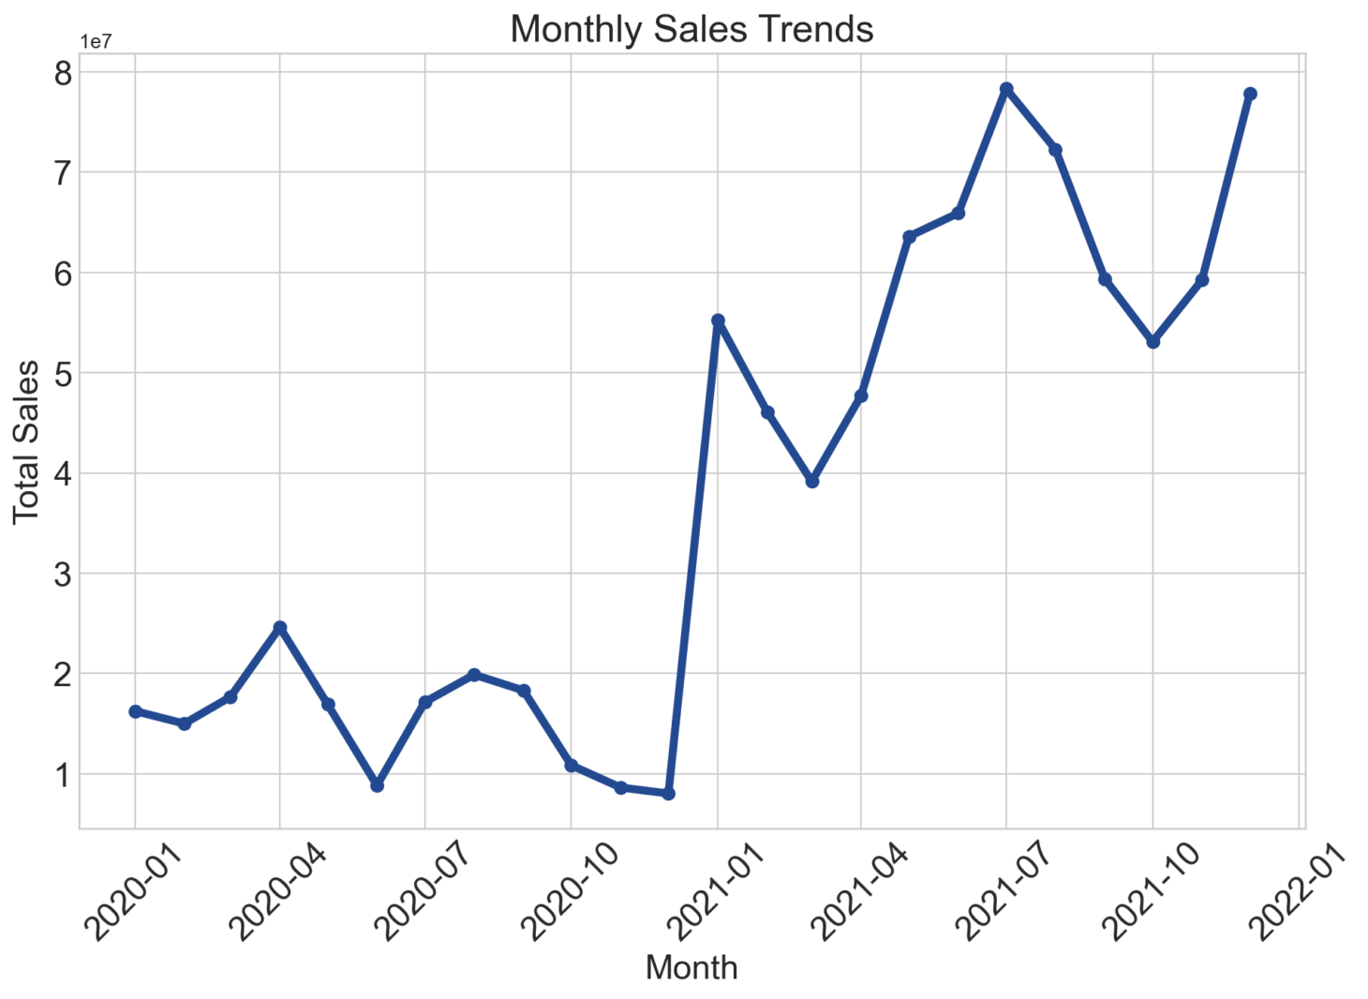
Time Series Analysis : Which months or years had the highest and lowest sales figures?
The analysis indicates a notable upward trajectory in sales throughout the year. Increase in sales was observed in April 2020, and growth spikes occurred in January, July, and December 2021, indicating shifts in customer behavior during these months.

Slide 12
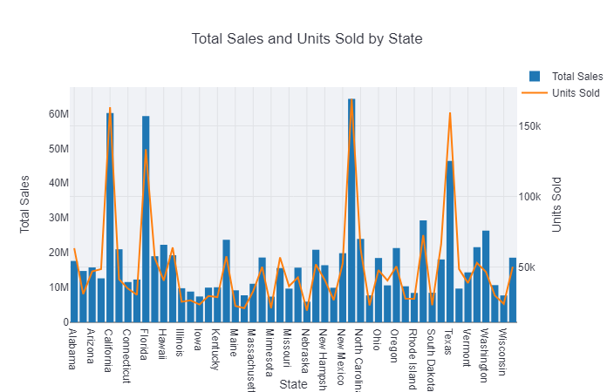
Regional Market Analysis : Which regions are experiencing strong sales, and which ones are lagging?
California and New York dominate in terms of total sales. The top performing State is New York with a total sales of $64,229,039, while the least performing State is Nebraska with a total sales of $5,929,038. Some states, like Texas, Florida, and Illinois, show moderate sales and units

Slide 13
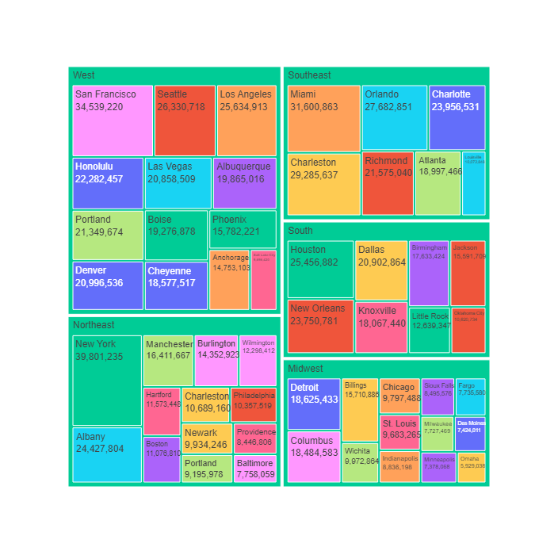
Regional Market Analysis : Which regions are experiencing strong sales, and which ones are lagging?
The top performing Region is West with a total sales of $269,943,182, while the least performing Region Midwest is with a total sales of $135,800,459.

Slide 14
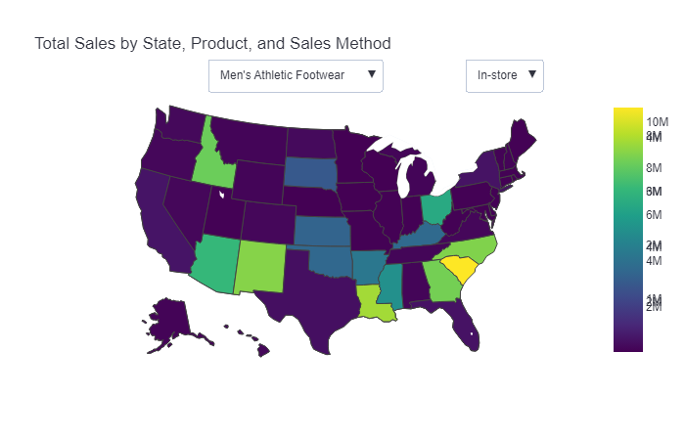
How does sales performance vary across different geographical regions?
This map is Demonstrating Total Sales by State, Product, and Sales Method in the US

Slide 15
Key Findings
1
Revenue Growth: In a challenging market environment, Adidas soared with an 80% increase in revenue compared to the previous year, reaching a staggering 717,821,450.
Product Performance: Dominating the sales charts, the footwear segment accounted for 66% of total sales for Adidas. Notably, within this segment, the apparel line saw a 34% surge in sales, underlining the significance of innovation and aligning with consumer trends.
Regional Sales Analysis: The West shone as Adidas’ largest market, contributing 30% to the total sales, while the North-east marked robust growth at 21%. The potential in emerging markets like the South-east, South, and Mid-West holds the key to Adidas' long-term expansion.
E-commerce Growth: With in-store sales climbing to represent 40% of total revenue, it's clear that enhancing the online and outlet shopping experience is vital. Optimizing digital marketing and utilizing data-driven insights for personalized customer experiences are essential strategies.
2
3
4

Slide 16


THANK YOU
FOR YOUR ATTENTION

